Slide 1

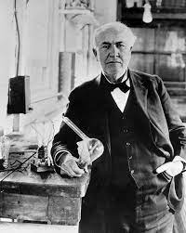
NPN-NMOS Transistor tracer
Dave Ve3OOI
march 2023
“I have not failed. I’ve just found 10,000 ways that won’t work"
Thomas Edison
This Project is a Textbook Example of Making Mistakes

Slide 2
The problem
You have a load that needs 350mA of current to work properly.
What transistor should you use?
What base resistor do you need to drive 100mA?
You need to have a quiescent current of 200mA through a MOSFET.
What bias do you apply to the MOSFET to get 200mA?
You need to have a reverse voltage protection diode with lowest voltage drop.
Which diode do you use from a bag of diodes you ordered from Digikey.
You are building a Class A RF amplifier and you need to set the bias point of the transistor so that it 100% linear.
What is the optimum bias point to use?
What base current do you need to get the desired output current?

Slide 3
AGENDA
The Transistor Tracer Hardware Version 1
Python Graphing Program
Summary of Various Transistor Curves (Not a Tutorial)
Data Sheet Comparison with Transistor Tracer Graphs
Diodes
NPN Transistors
Enhancement Mode MOSFETS
Changes in Version 2
This is not a Transistor Tutorial. Its assumed you understand how a BJT and MOSFET operates and terms (e.g., Vbe, Vgs, Vce, Vds, etc). Only a short summary if given

Slide 4
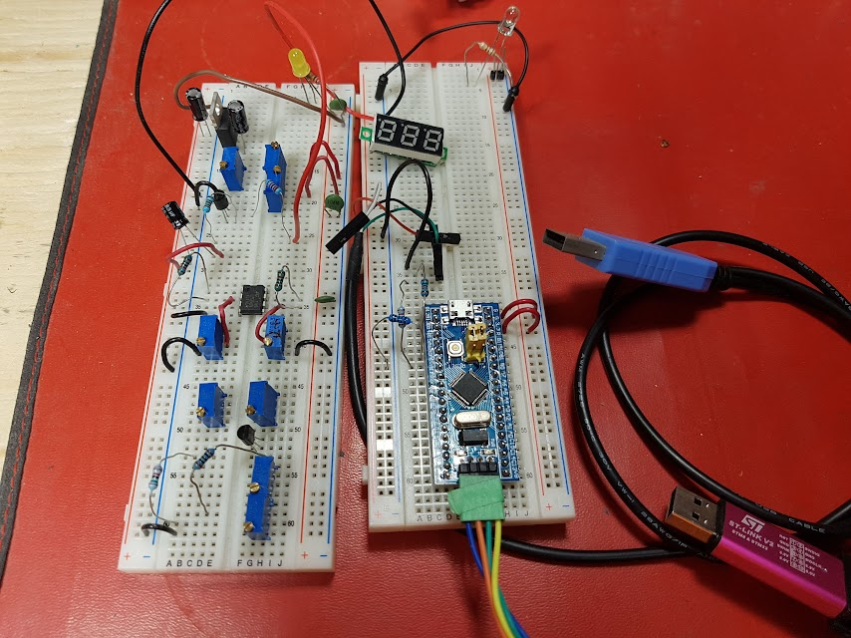
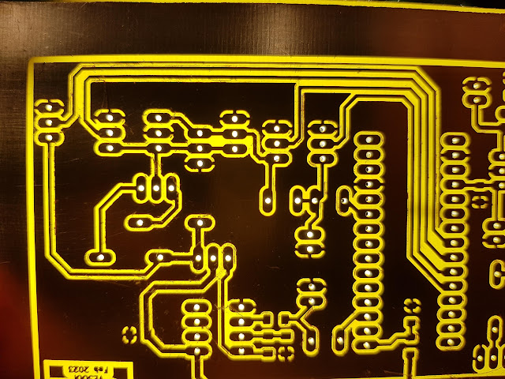
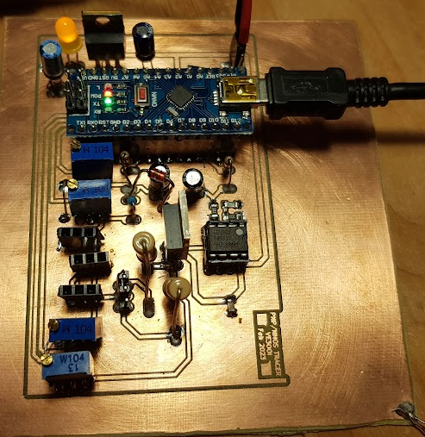
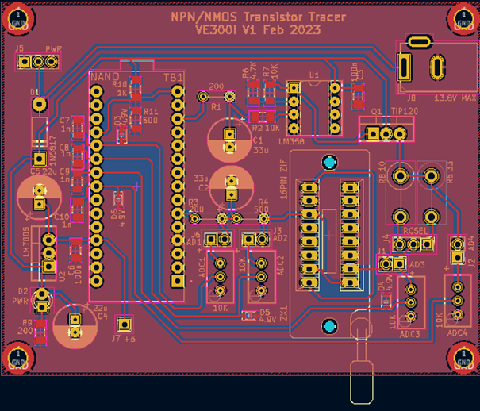
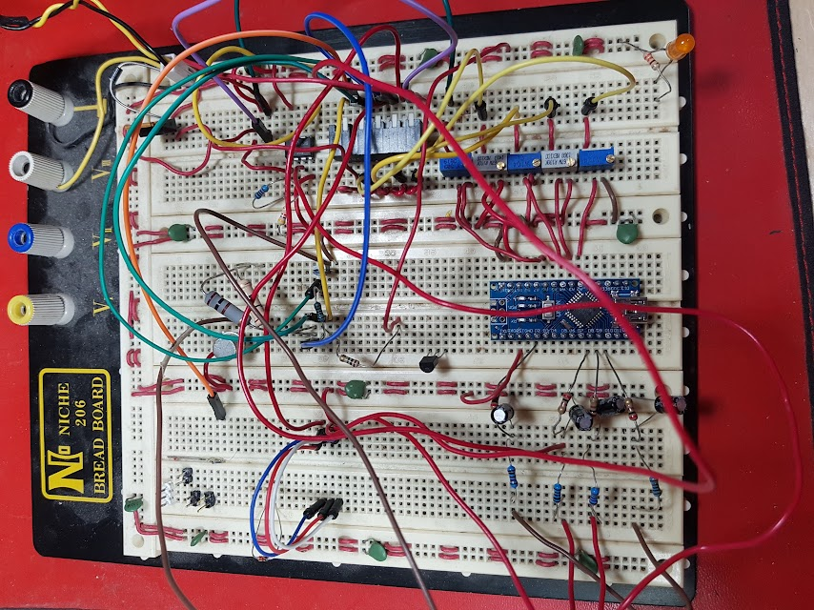
TRANSISTOR TRACER V1 evolution
Drop PNP and PCHAN MOS Functionality

Slide 5
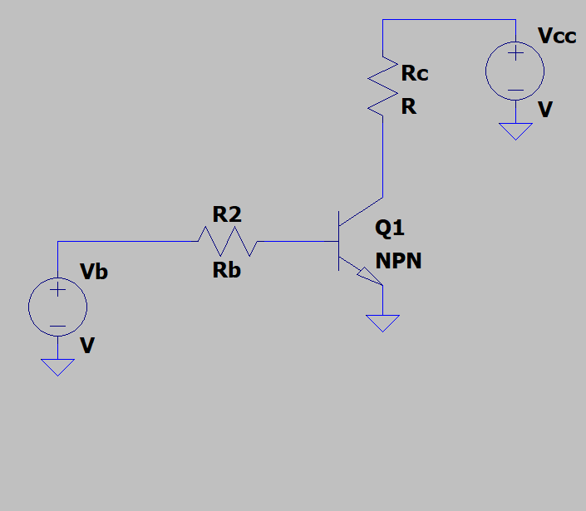
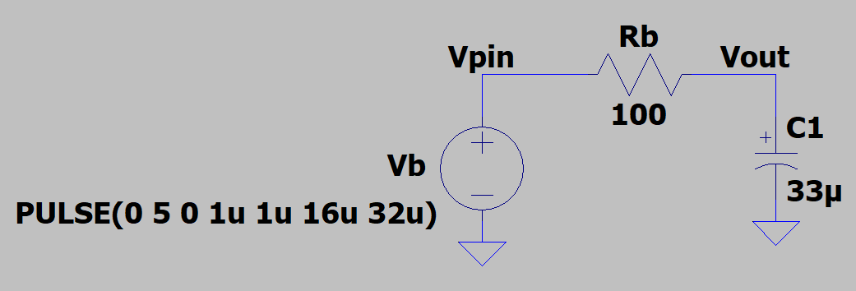
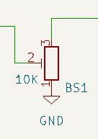
How it works
Use Arduino ADC to measure voltage difference and measure Vce, Vcc, Ic
Use Arduino PWM and a LPF to generate a DC voltage
Pots uses as a resistive divider to keep ADC voltages below 5V
Use Arduino ADC to measure voltage difference and measure Vbe, Ib, Vb

Slide 6
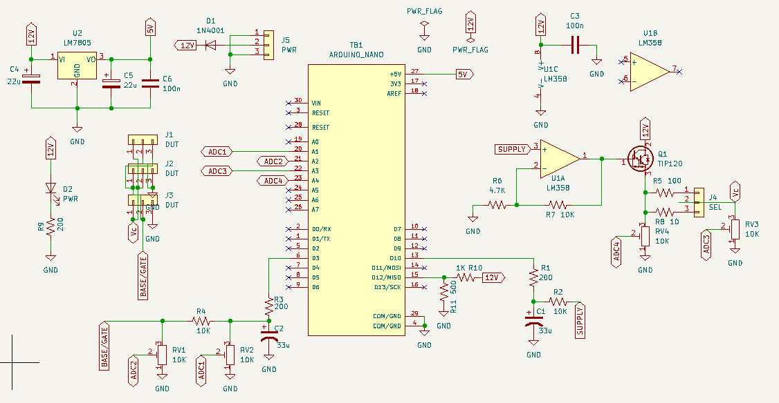
SCHEMATIC
462

Slide 7
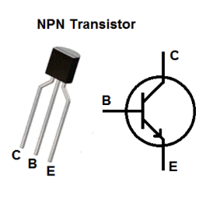
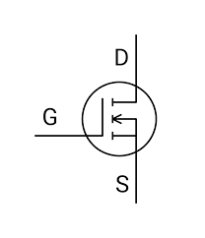
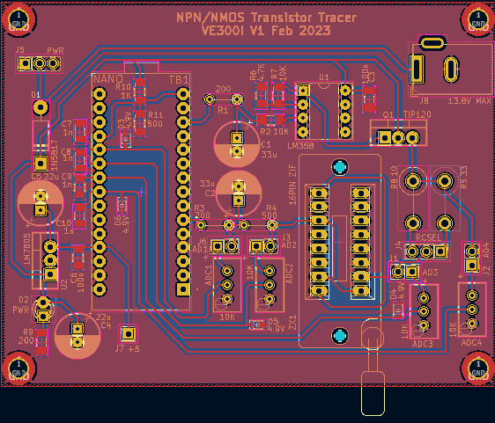
version 1: Speeds and feeds
NPN BJTs with EBC, BEC, BCE
NMOS (N Channel Enhancement Mode MOSFET) with GDS, GSD, DGS
Vcc 14V, Max Collector/Drain Voltage: 10@930mA
Max Base/Gate voltage: 4.3@7mA

Slide 8
PC Interface – python Microcontroller Console

Slide 9
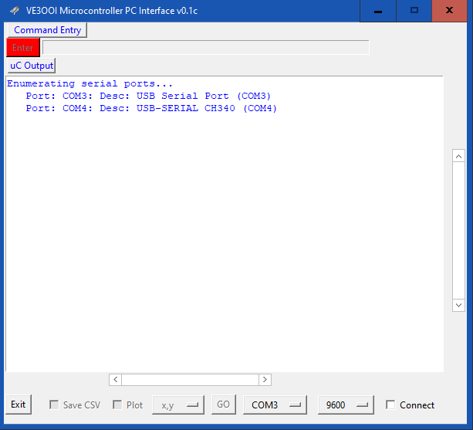
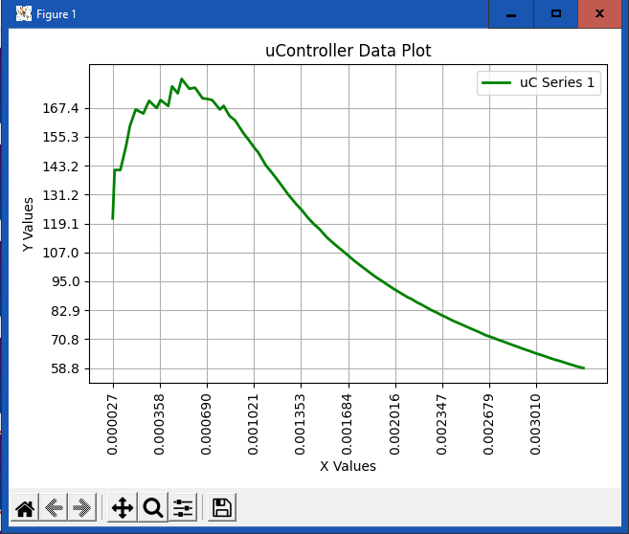
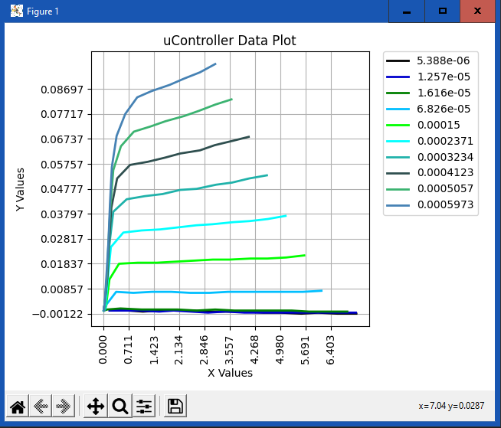
Microcontroller console
Data acquisition program written in python for PC
https://github.com/drajnauth/uC_Console
Used to acquire and plot data from a microcontroller
Data is needs to be written to serial console in a specific format
Data to be captures has “#” at start of line
Finish data set with a “|”
Create a new series with a “=“
Currently supports
Plot after all data received: x-y plots, s-x-y series
Plot as data arrives (live plot): y, x-y, s-x-y
S-X-Y
X-Y
YOU MUST PROGRAM uC TO SEND DATA

Slide 10
Microcontroller console: connection
Enter command to be sent to uC
(same as Arduino Serial Console)
Serial Ports available to connect to
Select com port from drop down
Select baud rate from drop down box
Select the “connect” checkbox to connect to the uC

Slide 11
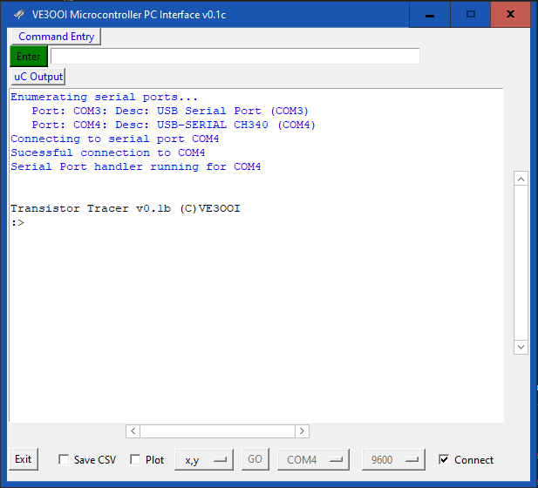
Microcontroller console: usage
Connection successful message
Text from uC is black. Text from program is blue
Select if you want to save data to a csv file or plot the data
Select the type of plot or the data series to save to csv file
When data has been successfully captures, the “GO” button will be enabled and you can press “GO” to generate the plot or save the csv file

Slide 12
HOW it works
Plotting Enabled for x,y Data
tni32
Rc = 32.00
:> BJT Input Sweep
Sweeping Vb 0.00 V to 4.60 V
Vc/Vd: 4.6000 Vb/Vg 0.0000 - 4.60 inc 0.23
Captured: 0.0, 0.0
Captured: 0.1886284065246582, 0.0
Captured: 0.4311506271362305, 0.0
Captured: 0.6601994037628174, 0.005473584175
Captured: 0.7140932083129883, 0.043788747787
Captured: 0.7410401344299317, 0.077472376823
Captured: 0.7545136451721192, 0.093472118377
Captured: 0.7814605236053467, 0.103998255729
Captured: 0.7814605236053467, 0.111577057838
Captured: 0.7949339866638183, 0.118734836578
Captured: 0.8084074020385742, 0.125050520896
Captured: 0.8084074020385742, 0.130524110794
Captured: 0.8218809127807617, 0.135576665401
Captured: 0.8218809127807617, 0.140629196166
Captured: 0.8353543281555176, 0.145681738853
Captured: 0.8353543281555176, 0.149471163749
Captured: 0.8353543281555176, 0.153681621551
Captured: 0.8488277435302735, 0.1570499897
Captured: 0.8488277435302735, 0.160418367385
Captured: 0.862301254272461, 0.163365659713
Captured 20 data pairs for 0 series. Press 'GO' to plot
:>
:> tni32
Rc = 32.00
:> BJT Input Sweep
Sweeping Vb 0.00 V to 4.60 V
Vc/Vd: 4.6000 Vb/Vg 0.0000 - 4.60 inc 0.23
#0.00000000000000000000,0.000000000000
#0.18862840652465820312,0.000000000000
#0.43115062713623046875,0.000000000000
#0.66019940376281738281,0.006315693378
#0.71409320831298828125,0.044209775924
#0.74104013442993164062,0.077472376823
#0.75451364517211914062,0.093472108840
#0.78146052360534667968,0.103577196598
#0.78146052360534667968,0.111156010627
#0.79493398666381835937,0.118313789367
#0.80840740203857421875,0.124629485607
#0.80840740203857421875,0.130103087425
#0.82188091278076171875,0.135576665401
#0.82188091278076171875,0.140208148956
#0.83535432815551757812,0.145260715484
#0.83535432815551757812,0.149471163749
#0.83535432815551757812,0.153260574340
#0.84882774353027343750,0.157049989700
#0.84882774353027343750,0.160418343544
#0.86230125427246093750,0.163365659713
|
:>
The Microcontroller must have a CLI
The uC must append “#” to numbers and send other control characters
# // x,y numbers
| // end control characters
= // switch control character
// i.e., new xy plot)

Slide 13
HOW it works
tno 32
Rc = 32.00
:> BJT Output Sweep
Sweeping Vb 0.00 V to 4.60 V
BJT NPN Output Sweep
Vb 0.0000 - 2.3000
Vc 0.0100 - 4.6000
#0.000000000000,0.000000000000,0.000000000000
#0.000000000000,0.848827743530,-0.000421045351
#0.000000000000,1.724602460861,0.000000000000
=
#0.000013473452,0.000000000000,0.000000000000
#0.000000000000,0.848827743530,-0.000421045351
#0.000000000000,1.724602460861,0.000000000000
=
#0.000013473480,0.000000000000,0.000000000000
#0.000013473480,0.835354328155,0.000000000000
#0.000013473480,1.724602460861,-0.000421043491
=
#0.000080840768,0.000000000000,0.000000000000
#0.000040420351,0.026946914196,0.001263136625
#0.000026946902,0.579358625411,0.004631500720
=
#0.000242522192,0.000000000000,0.000000000000
#0.000229048728,0.000000000000,0.000842091083
#0.000161681470,0.107787656784,0.017683911323
=
#0.000431150627,0.000000000000,0.000000000000
#0.000417677164,0.000000000000,0.000842091083
#0.000377256870,0.067367286682,0.019368094444
=
#0.000646725940,0.000000000000,0.000000000000
#0.000633252525,0.000000000000,0.000842091083
#0.000579358673,0.053893828392,0.019789141654
=
|
:>
Series Id (not used to plot)
X data point
The Microcontroller must have a CLI
The uC must append “#” to numbers and send other control characters
# // x,y numbers
| // end control characters
= // switch control character
// i.e., new xy plot)
Y data point
Switch to new XY plot
End of data. Enable plot

Slide 14
CLI Manual

Slide 15
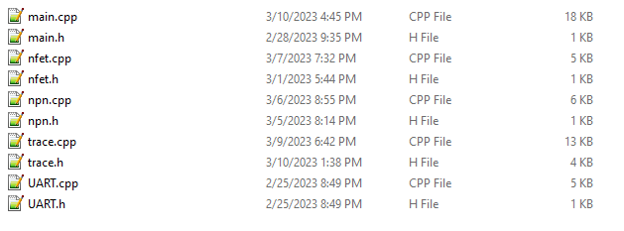
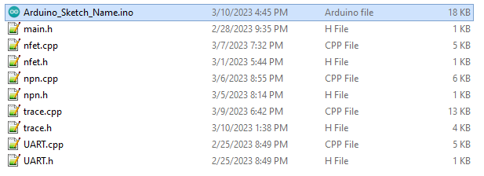
Arduino software (firmware)
This software was compiled using PlatformIO IDE. As is it will NOT compile with Arduino IDE.
For Arduino IDE, simply rename the main.cpp to an Arduino program name (*.ino). Then create a directory with the same name and store all .cpp and .h files in that directory

Slide 16
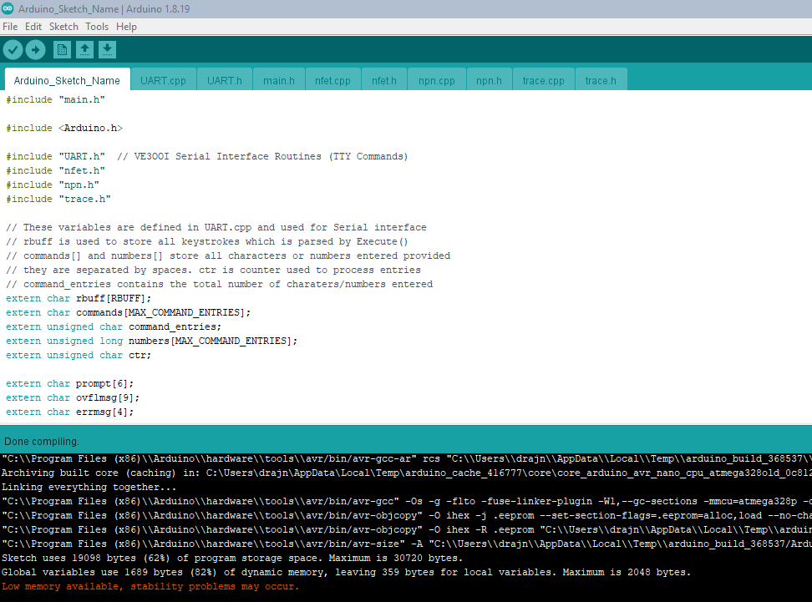
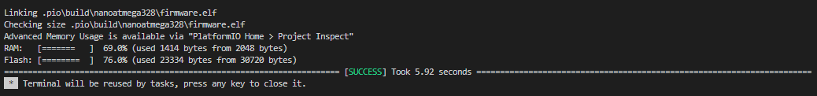
Arduino IDE vs PLATForm.IO
Arduino PlatformIO
RAM 1689 1414
FLASH 23334 19098

Slide 17
CLI Guide: SUMMARY
H // Help – Command summary
C // Display current Calibration
C [R|M|D] // Calibrate
D // Set default values
E [I|P] // Configure EEPROM
M [R] // Measure Voltages
P [3|10 [255] // Set PWM on pin 3 or pin 10
R // Reset
S [V] [B|C] [O] [mV] // Set voltage on Base or Vcc pin.
S [I] [uA] // Set current on Base
S [U] [D|M|U] // Set default unit to decimal, Milla or Micro for currents
S [M] [B|C] [min] [max] // Set min max voltage to sweep
S [R] [B|C] [R] // Set Rb or Rc resistor values
S [P] [B|C] [n] // Set number of data point in sweep between max and min
T [NI|NIV|NO|NB|NBC|NR|NG] // Trace NPN Transistor
T [FI|FIV|FO|FK|FG|FR] // Trace N Chan MOSFET
T [DI|DO] // Trace Diode

Slide 18
CLI Guide: Calibration
Display current Calibration values
C
Connect the Tracer to Vcc with empty socket (nothing connected) to determine the voltage sweep range for base/gate voltage and collector/drain voltage. It also calculated the conversion constant to convert collect/drain (pin 10) PWM voltage to actual output Vcc voltage delivered to DUT
C M
Connect the Tracer to Vcc with empty socket (nothing connected) to determine the voltage sweep range for base/gate voltage and collector/drain voltage. It also calculated the conversion constant to convert collect/drain (pin 10) PWM voltage to actual output Vcc voltage delivered to DUT
C D
Connect the Tracer to Vcc with empty socket (nothing connected). It generates a PWM voltage on collector/drain pin defined by a calibration voltage constant (see below) and then measures and displays all ADC values 10 times. This is one way to calibrate ADC pots.
C R

Slide 19
Calibration & CONFIGURATION for Version 1
Before powering up Arduino, you need to calibrate pots to not damage the Arduino.
Remove Arduino. Remove jumpers from all trim pots jumper headers pins.
Measure the voltage at the +5V terminal pin (J7).
Connect a jumper wire from +5V terminal to each pot’s jumper “+” pin (J1, J2, J6, J7). “+” is marked on the silkscreen
Adjust each pot until you get 1.75V output (exactly) at the pot’s wiper. Use one consistent VOM.
Insert Arduino and load the code. Power up.
Connect via TTY console to Arduino. Enter the C R command to display all ADC values from each pot
Note that each pot has ADC1, ADC2, ADC3, ADC4 marked on the silkscreen. Each jumper associate with the pot is marked as AD1, AD2, AD3, AD4. This corresponds to the ADC number on the Arduino.
Connect 5V to the same jumper in step 3. Note the ADC number of the jumper and pot.
Adjust the pot’s wiper (very fine adjust needed) until the corresponding ADC displayed by the Arduino is 364. Repeat for all jumpers/pots.
Enter the R command to reset the Arduino when done
Complete and record the following calculations for each pot:
Calculate VOLTAGE_DIVIDER = V(wiper)/V(applied) e.g., 1.75/5 = 0.357
Calculate ADC_CONVERSION = ADC_Value/V(wiper) e.g., 364/1.75 = 208.0
Calculate VOLTAGE_CONVERSION = VOLTAGE_DIVIDER * ADC_CONVERSION e.g., 0.357*208 = 78.0
Take the average VOLTAGE_CONVERSION and update the #define ADC_CONVERSION ((float)78.0) in the defines.h file
You need to measure the resistance of the Base and Collector resistors. Update the following defines in the defines.h file
#define RC_RESISTORHIGH 32
#define RC_RESISTORLOW 10
#define RB_RESISTORLOW 462
Compile and load the Arduino program before continuing. The above defines must be in place.
Complete the following. DO NO RESET OR POWER OFF ARDUINO UNTIL ALL STEPS ARE COMPLETE. Failure will result in redoing below
Set the base resistor value using the S R B nnnn command where nnnn is the resistor value. E.g., S R B 462
Set the jumper J4 (RCSEL) to the resistor for the sweep. Use the S R C nnnn command to define the Collector resistor nnnn that the jumper selected. E.g., S R C 10
With Vcc applied and nothing connected to the ZIF socket (socket is empty), run the C M command to have the Arduino figure out the max voltages available to it during a sweep. If you change Vcc, this needs to be repeated.
Update the EEPROM with the configuration by entering the E W command. Once completed, the Arduino will power up with these values.
Your transistor curve trace (V1) is now ready.

Slide 20
Operation: SWEEPS
The transistor tracer sweeps a set of PWM voltages.
There is a base/gate PWM voltage (Pin 3) that is applied directly to the transistor under test.
There is a Vcc PWM voltage (Pin 10) that is amplified by an opamp and a high-power transistor
Since the base/gate PWM voltage is fed directly to the transistor under test, the base/gate voltage is essentially the output voltage to the transistor
However, since the Vcc PWM voltage is amplified, the output voltage fed to the collector/drain of the transistor under test is different.
When sweeping Vcc values, only the PWM voltage is used. When you set voltage ranges, you are setting the PWM voltage that the Arduino outputs.
You can manually set the output voltage supplied to the transistor under test using the S V command. However, this is a one-time setting. Its not used in a sweep. BE CAREFULL SETTING VOLTAGES MANUALLY – you could destroy a resistor or the transistor under test if you exceed its maximum ratings
REMEMBER: When you set voltage ranges, you are setting the PWM voltage that the Arduino outputs. You are NOT setting the output voltage fed to the transistor under test

Slide 21
Operation: NPN Sweeps
The T command is used to complete Traces. The T N command is used to complete NPN Transistor traces
The following traces uses the configured min and max voltages. You can adjust sweep voltages and number of data points (resolution) to be taken during a sweep. Use the S M command to adjust min & max voltages for and S P to set data points.
The following below outlines the various traces:
Input Trace: T N I
This command sets the Vcc voltage to the maximum available voltage and then sweeps the base voltage from configured min to max at define inc (resolution). It prints out Vbe vs Ic
Input Trace: T N I V
This command is the same as above except it prints out Vbe vs Vce
Output Trace: T N O
This command sweeps the base voltage from configurated min to max with inc. For each base voltage, it then sweeps Vcc from configured min to max at defined inc. For each base voltage it print out Vce vs Ic in the form Ib, Vce, Ic
Beta Trace: T N B
This command sets the Vcc voltage to the maximum available voltage and then sweeps the base voltage from configured min to max at define inc (resolution). It calculates transistor beta and prints out Ib vs Beta
Beta Trace: T N B C
This command is the same as above except it prints out prints out Ic vs Beta
Beta Trace: T N R
This command sets the Vcc voltage to the maximum available voltage and then sweeps the base voltage from configured min to max at define inc (resolution). It calculates transistor re (intrinsic resistance) and prints out Ic vs re
Beta Trace: T N G
This command sets the Vcc voltage to the maximum available voltage and then sweeps the base voltage from configured min to max at define inc (resolution). It calculates transistor transconductance and prints out Ic vs g_{m}

Slide 22
Operation: N-CHANNEL enhancement mode MOSFET Sweeps
The T command is used to complete Traces. The T F command is used to complete N channel Mosfet traces
The following traces uses the configured min and max voltages. You can adjust sweep voltages and number of data points (resolution) to be taken during a sweep. Use the S M command to adjust min & max voltages for and S P to set data points.
The following below outlines the various traces:
Input Trace: T F I
This command sets the Vcc voltage to the maximum available voltage and then sweeps the gate voltage from configured min to max at define inc (resolution). It prints out Vgs vs Id
Input Trace: T F I V
This command is the same as above except it prints out Vgs vs Vds
Output Trace: T F O
This command sweeps the base voltage from configurated min to max with inc. For each gate voltage, it then sweeps Vcc from configured min to max at defined inc. For each gate voltage it print out Vds vs Id in the form Id, Vgs, Id
Intrinsic Resistance Trace: T F R
This command sets the Vcc voltage to the maximum available voltage and then sweeps the gate voltage from configured min to max at define inc (resolution). It calculates transistor re (intrinsic resistance) and prints out Id vs Rds
Transconductance Trace: T F G
This command sets the Vcc voltage to the maximum available voltage and then sweeps the gate voltage from configured min to max at define inc (resolution). It calculates transistor transconductance and prints out Id vs g_{m}
Transconductance Trace: T F G
This command is the same as above except it it calculates transistor transconductance constant K and prints out Id vs K

Slide 23
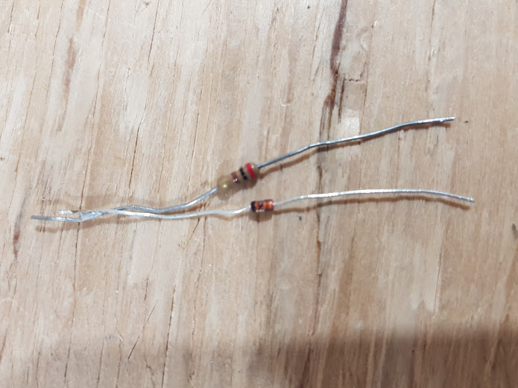
Operation: diode Sweeps
The T command is used to complete Traces. The T D command is used to complete diode traces
The following traces uses the configured min and max voltages. You can adjust sweep voltages and number of data points (resolution) to be taken during a sweep. Use the S M command to adjust min & max voltages for and S P to set data points.
Note that the diode MUST be oriented correctly in the socket.
The following below outlines the various traces:
Input Trace: T D I
The diode must be connected between the base/gate socket and ground. The cathode is connected to emitter/source socket (ground). For a Zener diode, its reversed, the cathode is connected to the base. This command sets the Vcc voltage to the maximum available voltage and then sweeps the base/gate voltage from configured min to max at define inc (resolution). It prints out Vb vs Id
Output Trace: T D O
The diode will need a resistor connected between the cathode and the emitter/source socket (ground). The resistor is selected to NOT exceed the maximum current the diode can handle. The resistor also protect the Arduino pin used for base PWM output (pin 3). Failure to add a resistor could cause damage to the Arduino. This command set the base/gate voltage Arduino pin to zero to sink current. It then sweeps the Vcc voltage from configurated min to max with inc. For each Vcc voltage, it measure the voltage drop across the collector/drain to the base/gate sockets along with current. It print out Vf vs I
Special Jig Required for Output Seep

Slide 24
Operation: custom sweeps
The S command is used to set trace values.
For base/gate voltage there is a min voltage, max voltage
Its sets the PWM voltage output from the Arduino. IT DOES NOT SET THE ACTUAL OUTPUT VOLTAGE DELIVERED TO THE DUT
Values MUST be entered as milla volts (mV) e.g., 4V entered at 4000
The following below outlines the various configuration options:
Base/Gate Sweep: S M B xxxx yyyy
This command sets the minimum voltage (xxxx) and the maximum voltage (yyyy) for the base/gate PWM pin. The increment use for trace is automatically calculated to the number of data point defined. Default is min: 0 and maximum determined by C M calibration command.
Vcc Sweep: S M C xxxx yyyy
This command sets the minimum voltage (xxxx) and the maximum voltage (yyyy) for the Vcc PWM pin. The increment use for trace is automatically calculated to the number of data point defined. Default is min: 0 and maximum determined by C M calibration command.
You need to enter the E W command to update the EEPROM configuration values or else these definition will be lost at next restart of the Arduino

Slide 25
Operation: custom sweeps
The S command is used to set trace values.
You can configure the number of data point to be taken during a typical sweep. Some sweeps such as the beta, gm, K and Rds and re sweeps typically take 25% of the increment.
Example:
If the min is 0.01V and the max is 4.6V
If you set the number of point to 10, then the increment uses during a sweep is (4.6 – 0.01)/20 = 0.45
Therefore, duing a sweep, 10 measurements are taken with each increasing by 0.45V from min to max.
The following below outlines the various configuration options:
Base/Gate Sweep: S P B xxxx
This command sets the number of data points to measure during a sweep of the base/gate voltage. The increment used for sweep is automatically calculated. Default is 10 data points for base/gate.
The range of allowed data points is defined in the defines.h file as:
#define MIN_NUM_VB_VOLTAGE 5
#define MAX_NUM_VB_VOLTAGE 20
#define NUM_VB_VOLTAGE 10 // Default number of points
Vcc Sweep: S P C xxxx
This command sets the minimum voltage (xxxx) and the maximum voltage (yyyy) for the Vcc PWM pin. The increment use for trace is automatically calculated to the number of data point defined. Default is 15 data points for Vcc.
The range of allowed data points is defined in the defines.h file as:
#define MIN_NUM_VC_VOLTAGE 5
#define MAX_NUM_VC_VOLTAGE 20
#define NUM_VC_VOLTAGE 15 // Default number of points
You need to enter the E W command to update the EEPROM configuration values or else these definition will be lost at next restart of the Arduino

Slide 26
Operation: EEPROM MANAGEMENT
The E command is used to manage configuration values stored in the EEPROM.
Configuration values stored in the EEPROM will be restored whenever the Arduino is power on.
The following below outlines the various configuration options:
Read EEPROM: E R
This command reads and overwrite the current running configuration with the configuration stored in the EEPROM. Any unsaved changes will be lost (i.e., changes to voltage ranges, points, resistor vales, max voltages, etc)
Write EEPROM: E W
This command write the current configuration to the EEPROM. It overwrites the EEPROM.
Initialize EEPROM: E I
This command sets the default configuration values, calculates the max voltages and then write the default configuration to the EEPROM. Think of this as a factory reset.

Slide 27
Operation: MISC MANAGEMENT
There are a few other MISC command that can be used:
Set Voltages: S V B xxxx or S V C xxxx
This set the PWM voltage at pin 3 (base voltage) and pin 10 (Vcc voltage). The voltage is given by xxxx and is in milla volts (i.e., mV). If O (Oh and not zero) is added after the B or C then, the Arduino tries to set the output voltage delivered to the transistor under test. Note that this value could be off by up to 0.5 volts.
Set PWM: P xx yyy
This command manually sets the PWM output of pin 3 or pin 10 of the Arduino and is used for troubleshooting. Xx is the pin number (3 or 10) and yyy is the PWM value (1-255). A higher PWM values will output a higher voltage.
Reset Arduino: M
This reads and display all the voltages and currents. It assumed you have manually set a voltage using the P or V commands
Reset: R
This resets the Arduino. Its not the same as a power on.
Set Defaults: D
This command sets the default parameter to the running config. It does not change the EEPROM config.
Set current units for graph: S U D or S U M or S U U
This command sets units for current values produced. S U D is used for normal decimal, S U M is used for milla and S U U is used for micro

Slide 28
Measurements of NPN BJT Transistors

Slide 29
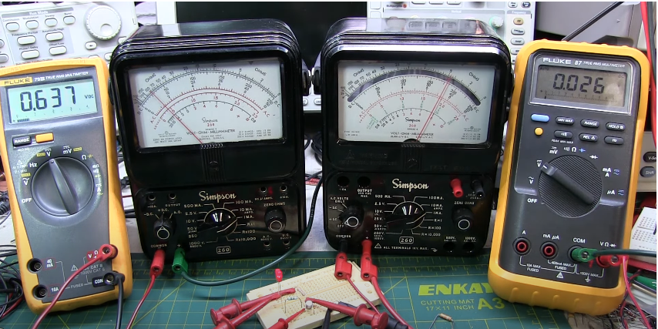
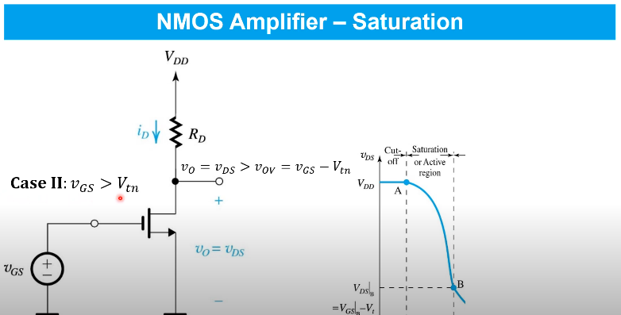


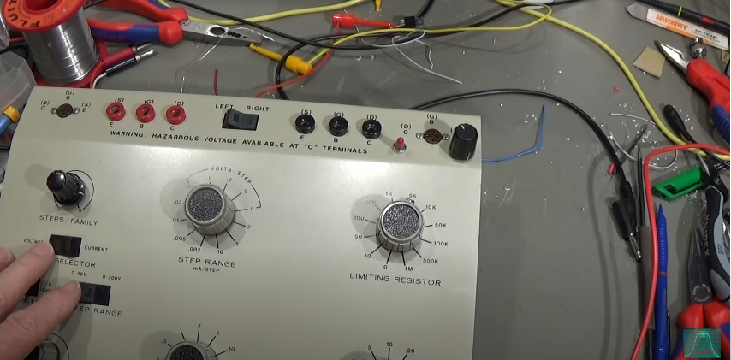
If you are looking for a TUTORIAL…
W2AEW: Back to Basics: Basics of the Bipolar Transistor - NPN and PNP
https://www.youtube.com/watch?v=IrAUC4ZoNYY&t=1263s
Microelectronic Prof. Tony Chan Carusone: Transistor Amplifier Basic Principles
https://www.youtube.com/watch?v=IrAUC4ZoNYY&t=1263s
Mateo Aboy: Series of Videos on BJT and FET Amplifiers
https://www.youtube.com/playlist?list=PLZvLSclgk4yJkRHB_eJ10zo2exTY_irR0
Electronics with Professor Fiore: Semiconductor Devices
https://www.youtube.com/playlist?list=PLxuejeK2BP_dtn1ijj1lZKrIs2gHPPsyp
MOS FET Modification Transistor Curve Tracer HeathKit
https://www.youtube.com/watch?v=rFmDUPVdYSc&t=4953s

Slide 30
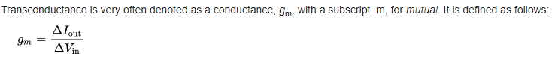
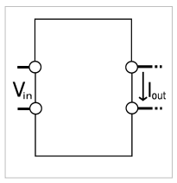
transconductance
A voltage applied at the input causes a current at the output.
Transconductance is a measure of the slope. It’s like a “transfer function”
This is a very important concept for MOSFETS
It is used with NPN Transistors, but they are more a current device

Slide 31


Transistor operation
NPN
Feed Small
Current into Base
NPN TRANSISTOR
Datasheets today use h_{fe} instead of Beta. Beta sounds “cooler”
Get a LARGE current between Collector and Emitter
N-CH
MOSFET
Feed
Voltage above Threshold
NMOS TRANSISTOR
g_{m}
Get a LARGE current between Drain and Source

Slide 32
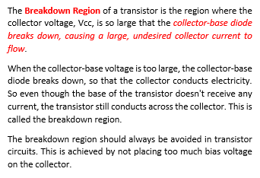
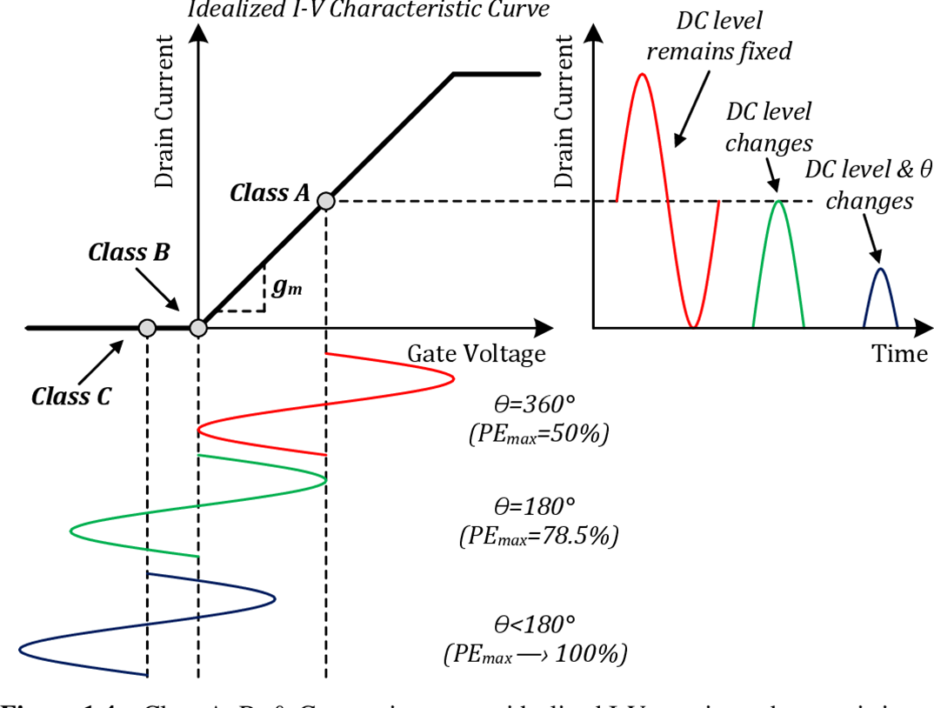
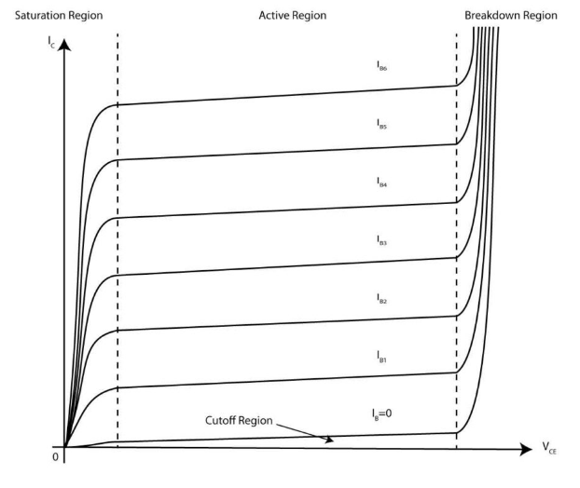
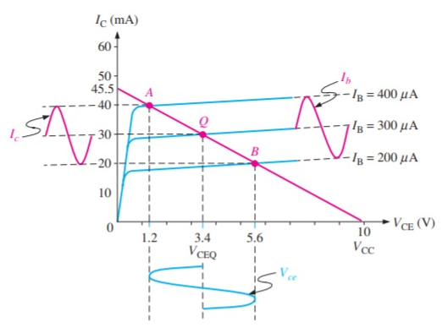
Transistor regions: voltage & current

Slide 33


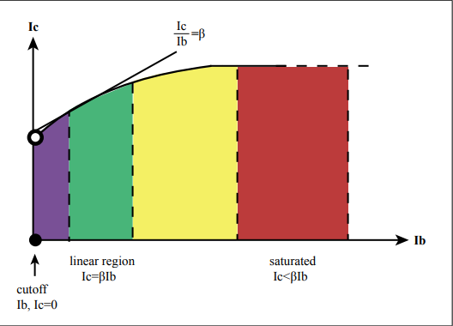
Transistor REGIONS: Current
Vbe(th)
Vbe(sat)
Amplification
No Amplification
Beta is not constant
Feed Small
Current into Base
TRANSISTOR
Get a LARGE current between Collector and Emitter
There is “Vbe(th)” for BJT, which is the threshold voltage (actually current) at which device starts conducting. Not specified on data sheet!!
There is Vbe(sat) for BJT, which is the maximum voltage at which collector current is constant.

Slide 34
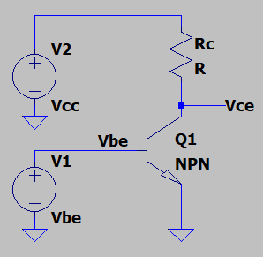
Transistor REGIONS: voltage
Vce=Vout
Cutoff
Region
Active Region
Saturation Region
Vcc
small
large
Vce(cutoff)
0
Vbe
Vbe(th)
Vbe(sat)

Slide 35
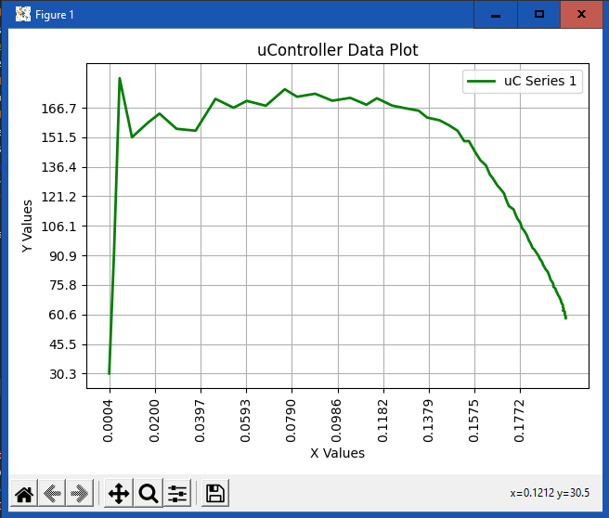
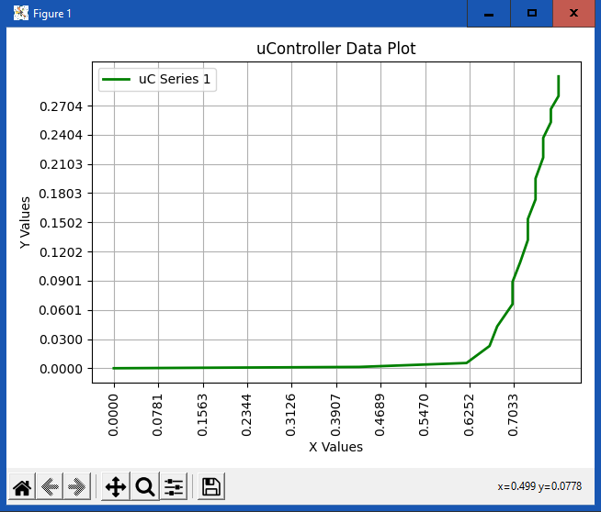
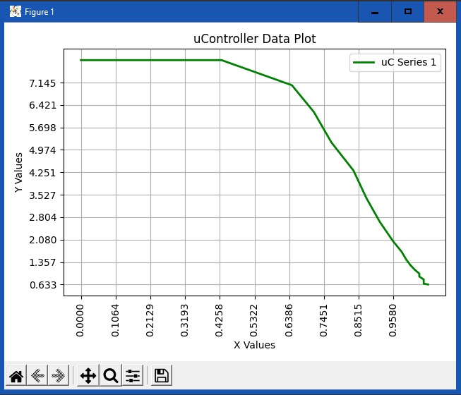
NPN Plots
Beta
Beta
Ic vs Beta
Vbe vs Ic
Ib vs Beta
Ic
Ic
Vbe
Ib
Ic
Ib: Vce vs Ic
Vce
Vbe vs Vce
Ib
Vce
Vbe

Slide 36
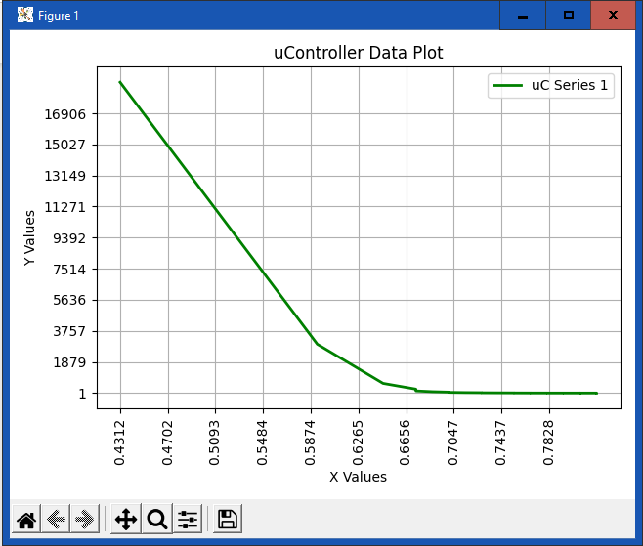
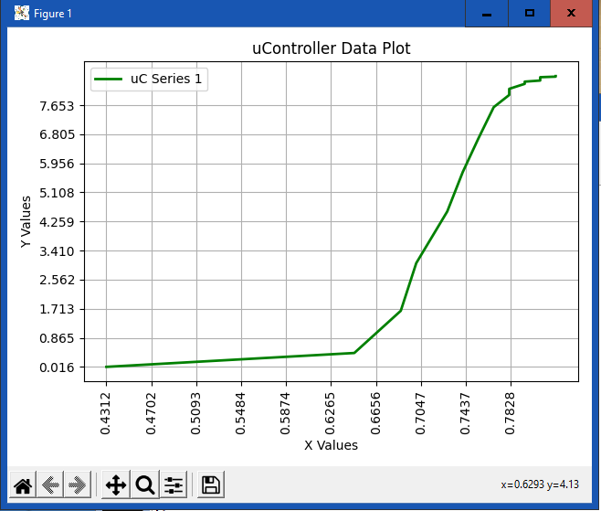
NPN Plots
Vbe vs re
Vbe vs gm
re
Vbe

Slide 37
Measurements of diodes and BJT devices

Slide 38
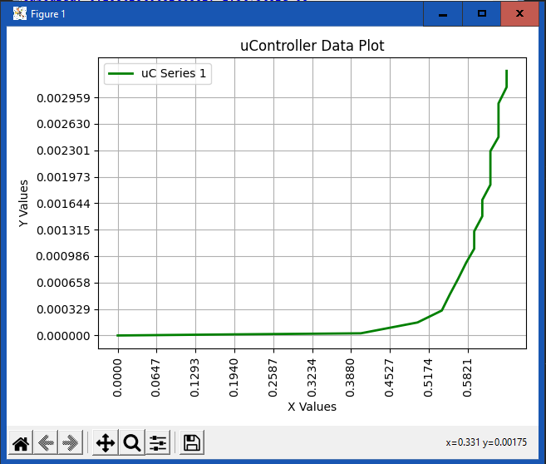
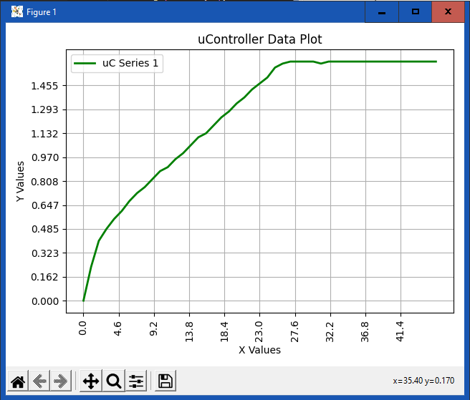
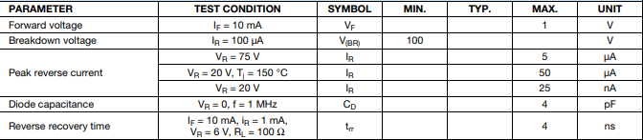
DIODE PLOTS: 1N914
Vf
V vs I
Vcc(i) vs Vf
Vcc(i)
Special Jig
Required

Slide 39
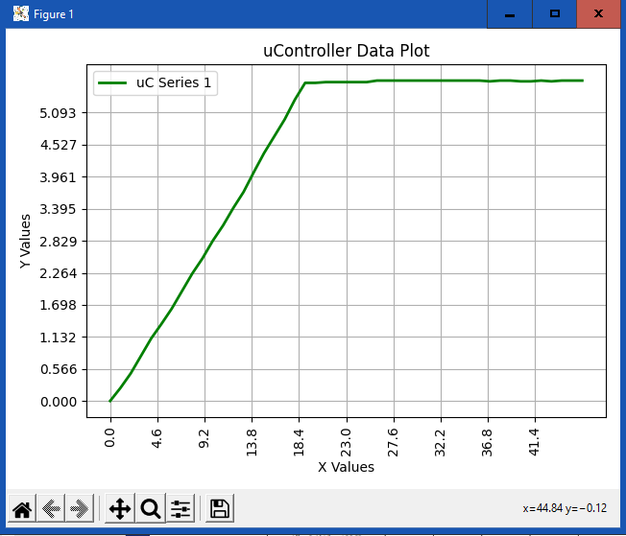
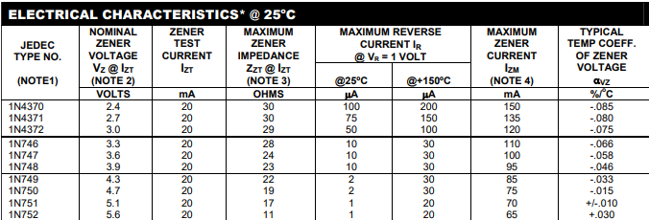
DIODE PLOTS: 1n752 (5.6Z)
Vcc(i) vs Vf

Slide 40
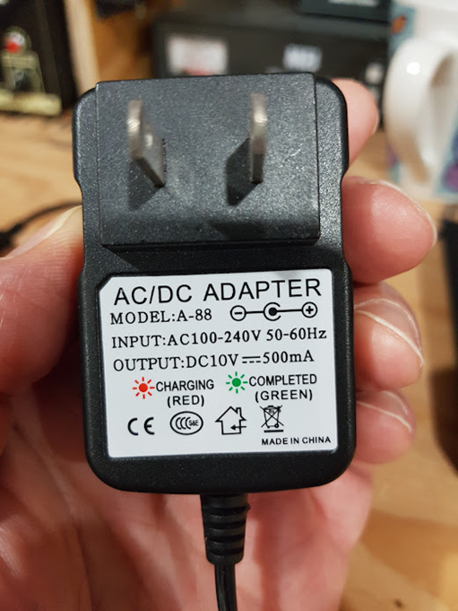

Slide 41
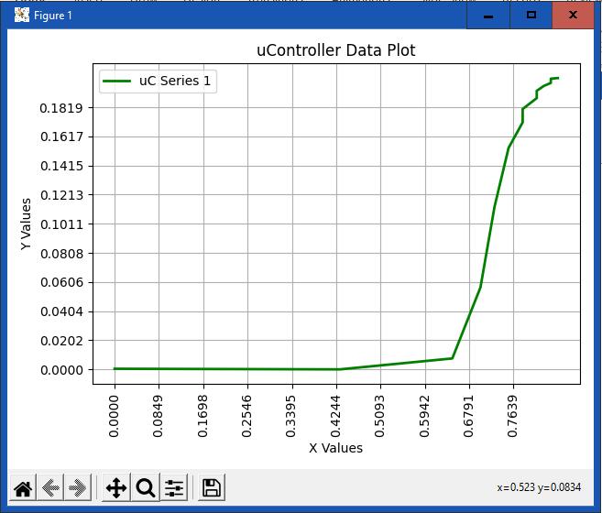
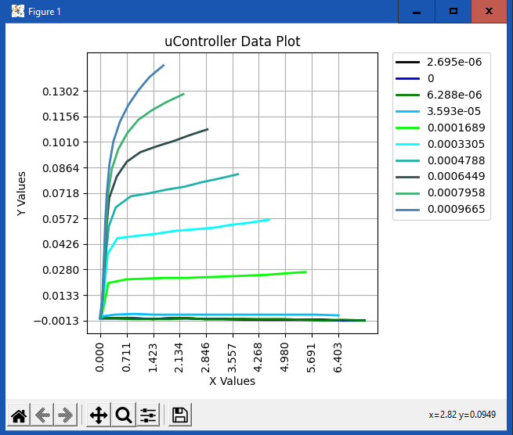
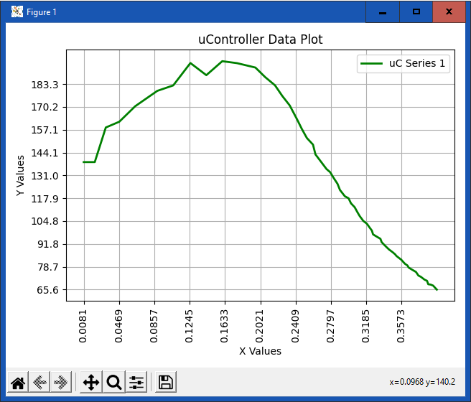
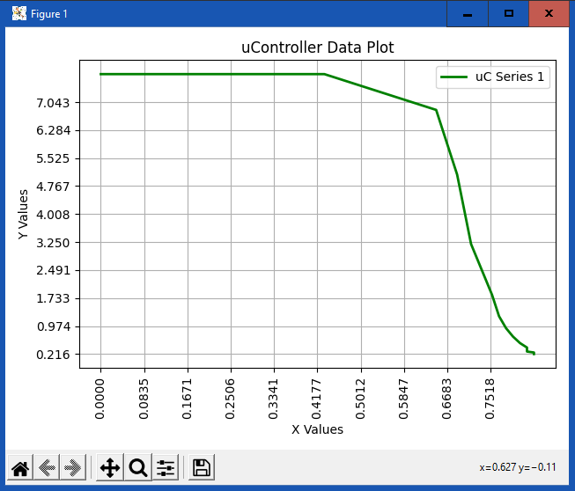
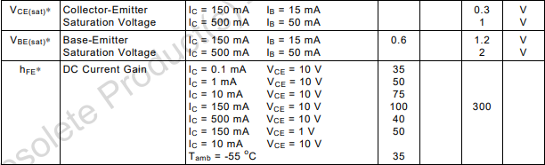
2N2222A
Vbe (sat)?
190
Vbe vs Ic
Ic vs Beta
Q
~ 0.8V
Actual roll over or Tracer Limitation
Active Region
Vbe vs Vce
Q
0.9V

Slide 42
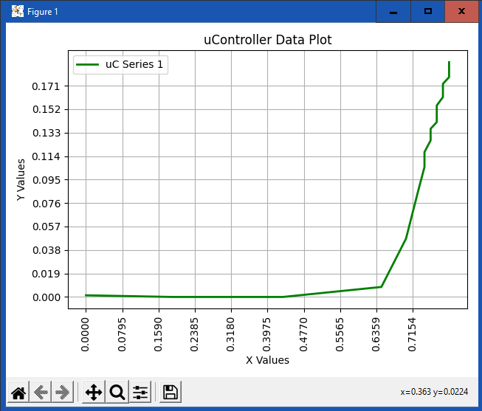




2n3904
Vbe vs Ic
260
Ic vs Beta
200
190
Vbe vs Vce
Limit for Vbe
MINIMUM

Slide 43





BC337
0.73V
Vbe vs Ic
320
Ib vs Beta
Actual roll over or Tracer Limitation
Vbe vs Vce
~ 0.7V

Slide 44



2N2219A
112
~ 0.9V

Slide 45



BD139
Ic vs Beta
Ib vs Beta
Plot is Beta vs Ib
(Ib is being sweeped – i.e., increasing
Prior plot is Beta vs Ic
(Ic is an an independent variable)
Beta
WTF – negative slope!!
Beta
PS Current Limit
500mA
Ic
Ib

Slide 46




BD139
PS Current Limit
500mA
250
0.8V
PS Current Limit
500mA
~ 0.7V

Slide 47





2N3050
170
PS Current Limit
500mA
< 0.9V

Slide 48





2sc5706
280
PS Current Limit
500mA
~ 0.7V

Slide 49
Measurements of n-channel enhancement MODE mosfets

Slide 50
Transistor operation
Feed Small
Current into Base
NPN TRANSISTOR
Datasheets today use h_{fe} instead of Beta. Beta sounds “cooler”
NPN
Get a LARGE current between Collector and Emitter
Feed
Voltage above Threshold
NMOS TRANSISTOR
N-CH
MOSFET
g_{m}
Get a LARGE current between Drain and Source

Slide 51

NMOS MOSFETS
Similar to BJT:
There is Vbe(turn on) for BJT, there is Vgs(on) or Vgs(th). This is threshold voltage at which device starts conducting
There is a maximum Vbe or Vgs where current is at maximum and constant. Vbe(sat) and Vgs(triode?). For MOSFET, Not specified on data sheet!!
NMOS

Slide 52

MOSFET REGIONS: voltage
Vds=Vout
Cutoff
Region
Active or
Saturation
Region
Triode or Ohmic
Region
Vcc
small
large
Vds(cutoff)
0
Vgs
Vgs(th)
Vgs(triode)

Slide 53





MOSFETS
Similar Input and Output charts to BJT:
However, the input curve will show saturation if Vgs is high enough
No concept of Beta (current amplification). MOSFET is a voltage device. Voltage controls current.
The gain depends on g_{m} (transconductance) and K
K is based on channel parameters inside MOSFET
Datasheets typically provide transconductance g_{m}

Slide 54





NMOS Plots
g_{m}
Id
Id
Vgs: Vds vs Id
Id vs g_{m}
Vgs vs Id
Vgs
Id
Vgs
Vds
k
Rds
Id vs k
Id vs Rds
Id
Id

Slide 55


2n7000
350mS
Vgs: Vds vs Id
Id vs g_{m}
2.5
Vgs vs Id
Saturation Region
Q
1.3V

Slide 56





BS170
280mS
3.2V
Active Region
1.50V

Slide 57





IRF510
0.5
3.0V
Don’t have the drive to measure this MOSFET

Slide 58





IRFZ20
500mS
3.30V
Don’t have the drive to measure this MOSFET

Slide 59






RD16HHF1
Vgs vs Id
Vgs vs Vds
Id vs gm
Don’t have the drive to measure this MOSFET

Slide 60
Issues
Need higher current and voltage for Vcc and Vb
Voltage drop from Opamp and TIP120 (~8V)
Using PWM (~4.3V) for Vb
Need better way to sweep Vcc/Vc
Need better socket for transistors

Slide 61



Version 2
ZIF Socket
DC Voltage Amplifier

Slide 62
version 2: Speeds and feeds
NPN BJTs with EBC, BEC, BCE
NMOS (N Channel Enhancement Mode MOSFET) with GDS, GSD, DGS
Vcc 14V, Max Collector/Drain Voltage: 11.1@1.7A
Vcc 14V, Max Base/Gate voltage: 11.1V@22mA
Version 1:
Vcc 14V, Max Collector/Drain Voltage: 10@930mA
Max Base/Gate voltage: 4.30@7mA

Slide 63


Slide 64


Slide 65


